Slide 1
Good work in a
Great City Council
HOW OUR WORKFORCE PLANS SUPPORT OUR WORKFORCE AMBITION

Slide 2
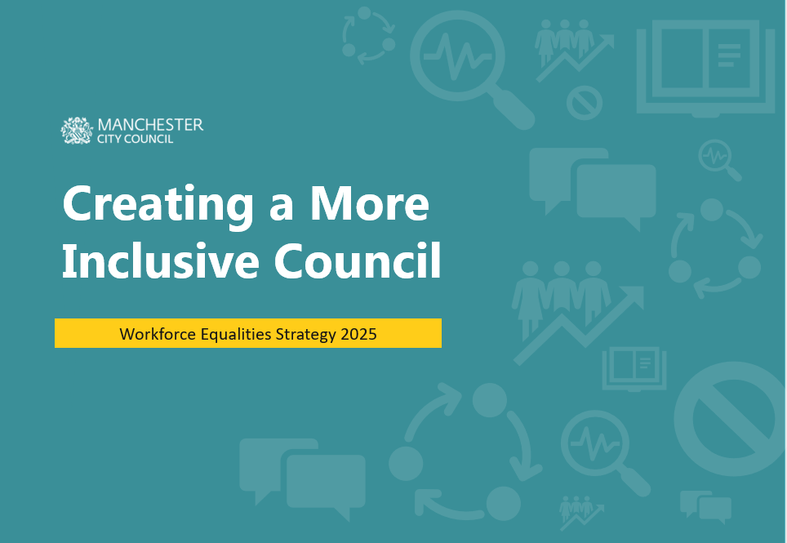
Our workforce strategies collectively deliver:
our workforce priorities:
Be an inclusive employer that represents the communities that we serve at all levels​
Attract, develop and retain talent
Be a thriving and healthy workforce
Develop world-class leaders and managers
Have a high performing workforce that delivers great services for our city​
to achieve our workforce vision:
Good work in a
Great City Council

Slide 3
Priorities and Impact

Slide 4
Health & Wellbeing Plan 2023-25:
The Health and Wellebing Plan sets out how we will create a healthy and high-performing workforce
PROMOTE AND ENCOURAGE GOOD MENTAL HEALTH AND WELLBEING
Ensure staff and managers have the knowledge, skills and tools to support having good mental health and wellbeing and that everyone feels that they can talk openly about stress and Mental Health
EMPOWER STAFF TO MAKE GOOD PHYSICAL HEALTH AND LIFESTYLE CHOICES
Empower our workforce to engage in healthy lifestyle choices by promoting physical activities, healthy eating and healthy lifestyles.
EMBED GOOD WELLBEING PRACTICES IN OUR LEADERSHIP
Support leaders (at all levels) to champion health and wellbeing and promote and prioritise the health and wellbeing of their teams and services.
STRENGTHEN HEALTH & WELLBEING COMMUNICATIONS & ENGAGEMENT
Develop first-class communications and engagement, ensuring everyone is connected to staying safe and well, and that they have a voice that is heard and reflected in decision making.
GROW OUR INCLUSIVE AND ACCESSIBLE FINANCIAL WELLBEING OFFER
Continue to strengthen our financial wellbeing offer which promotes financial literacy, provides access to affordable borrowing and advances and respond directly to the cost-of-living crisis.
HEALTHY AND INCLUSIVE WORKPLACE
Ensure that staff work in environments that promote wellbeing, which are open and inclusive, with a good work-life balance and a sense of role fulfillment.

Slide 5
Organisation Development Plan 2023-25:
The purpose of the Organisation Development Plan is to improve the effectiveness and performance of the organisation by aligning processes and systems, with culture of the organisation
Performance Development
Building on the first iteration of performance and development to overcome some of the challenges around time, prioritisation and accountability at all levels.
Leadership
Supporting leaders now and for the future through a new leadership framework that defines what it means to lead in this organisation, with clear expectations, support and guidance.
Recognition & Staff Voice
Developing a compassionate, individualised approach to recognition that is consistent and aligned to staff voice, positive experiences of work and our organisational purpose
Decision & Risk
Renewed focus of supporting people to make the right decisions through informed thinking and risk tolerance, and ensuring accountability is at the right level.
Notes:
Decision/risk - focused on levels of authorisation and risk appetite. Learned RA at a senior level is quite high, and at a lower level there’s low appetite to change levels of authority ( eg trusted to manage million pound budgets but need your manager to order your phone, SLG authorising stationary orders) Need to focus more on accountability, working with Risk and Audit
GMG – great traction and will be delivered through BAU but line mgrs struggling to prioritise 121s/well being conversations. Can’t ‘give’ time but need to help with how mgrs make space for these. Will help with how we get further upstream on some of key workforce challenges such as sickness absence (preventing crises)
Leadership Framework - Great work on mgr support but nothing for leaders – specifically leaders that MCC needs. Not a generic framework you can google but something specific to MCC that focuses on the skills needed to lead in MCC for MCR – cultural competence, understanding place, better use of data to inform decision making etc
Reward and recognition – didn’t get to this as needs to be in the context of HWB, GMG and WES. Spectrum from recognising the value of contributions by listening and actioning (where possible and appropriate to do so), managing evolving expectations of staff by being up front about what we can and can’t do, celebrating the small as well as the big (thank you in passing through to formal recognition). All rooted in ongoing psychological safety work.

Slide 6
Talent Plan 2023-26:
The Talent Plan sets out what we will do throughout over the next 3 years to attract, develop and retain talent at all levels.
Improve approaches to recruitment and retention
Strengthen pathways into employment at Manchester City Council
Strengthen our internal pathways and progression
Maximise Apprenticeships, Graduates, Work Experience & Interns

Slide 7
Workforce Equality Strategy 2021-23:
The Workforce Equality Strategy (WES) which sets out how we will achieve our vision of the Council fully reflecting the diversity of the communities that we serve at all levels and to be a place where our workforce can be themselves and thrive.
Attract, recruit and select in a way that is inclusive and drives diversity at all levels
Educate, develop and build talent in our workforce
Strengthen visibility and voice of staff networks, equality champions and allies
Be clear in our zero tolerance to discrimination
Set and monitor targets across a range of measures
Create policies and processes that feel fair to everyone

Slide 8
What will be the impact of the workforce plans?
Over time, we’d expect to see the following impact as a result of the workforce plans.
The experience of delivering our work will become more efficient and effective, we will know this through:
quicker and more efficient decision making that is evidence based and takes a positive approach to risk
all staff having access to the tools, knowledge and skills to be successful at work and resilient to change, with supportive managers
performance being well managed, with all staff having up-to date development plans and timely, constructive 121s
Our leadership and management individually and collectively support our organisation to be successful, we will know this because:
managers have the support they need to be high-performing managers, who understand and are fully supported in their role as a line manager
we have Greater diversity represented across our leadership and management roles
leadership is recognised and celebrated at all levels of the organisation
We will see increased motivation across all our staff team, we will know this through:
improved engagement rates in staff survey and corporate engagement initiatives
improved employee experience as reported in the annual staff survey
sustained improvement in key employee performance metrics such as sickness absence, grievance and disciplinary
As an employer of choice we will attract and retain a diversity of talented people, we will know this by:
improved ability to attract, recruit, retain talent thus becoming an employer of choice
increased diversity in the organisation through career and succession planning, and the end-to-end recruitment process

