Slide 1
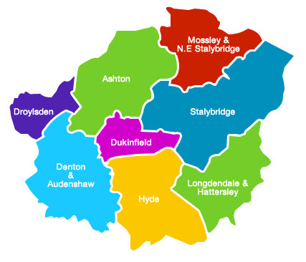


Tameside Strategic Commission
Finance Update Report
Financial Year 2022/23
Month 5 – 31st August 2022
Kathy Roe
Asif Umarji

Slide 2
Financial Year 2022-23
Period 5 Finance Report
 | Executive Summary | 3
 | Integrated Commissioning Fund Budgets | 4
 | Integrated Commissioning Fund Commentary | 5 – 6
 | ICFT Position | 7 – 8
This report covers spend across the Tameside Strategic Commission (Delegated Tameside Locality budgets from Greater Manchester Integrated Care Board (ICB), Tameside Metropolitan Borough Council (TMBC)) and Tameside & Glossop Integrated Care Foundation Trust (ICFT).
Forecasts reflect a full 12 months for TMBC, but only 9 months for the ICB for the period 1 July 2022 to 31 March 2023.
It does not incorporate financial data for Tameside & Glossop CCG, which ceased to exist on 30 June 2022. The CCG closedown position has been reported separately.
The report does not capture any health spend relating to Glossop, where commissioning responsibility was transferred to Derby & Derbyshire ICB from 1 July 2022.

Slide 3
Finance Update Report – Executive Summary
Tameside & Glossop CCG formally closed down on 30th June 2022, with responsibilities transferring to either Greater Manchester ICB or Derby & Derbyshire ICB. As such the scope of this report is different to that of previous months.
Reporting for TMBC and ICFT continues as usual, but the CCG position has been replaced by budgets delegated to the Tameside Locality by GM ICB. The report no longer includes any health spend relating to Glossop, where commissioning responsibility was transferred to Derbyshire.
Month 5 is the second month in which the ICB has been operational. As such final approved delegated budgets at locality level have not yet been confirmed. Work is ongoing to finalise budgets, but in the meantime this report presents indicative locality budgets.
Plans for Tameside were submitted for delivery of a £595k surplus in 22/23. At M5 we assume that this plan will be delivered, which in line with wider ICB reporting for M5. The plan to deliver a surplus requires savings of £7.8m to be found, and whilst there is risk of achievement, it is currently expected that Tameside will be on target, however work continues to ensure that savings identified become recurrent.
As highlighted previously, the Council is facing significant and growing inflationary pressures across a number of areas, combined with demand pressures in Adults and Children’s services, resulting in a significant forecast overspend by 31 March 2023 of £11,117k. This represents a £1,188k improvement since M4, driven largely by additional investment income resulting from increases to interest rates.
Ongoing demand and cost pressures on Council budgets will have implications for the 2023/24 budget and work is in progress to identify mitigations for 2022/23, whilst planning for 2023/24.
ICB Locality Position
Final delegated budgets for localities are not yet in place. As such indicative budgets have been reported, with an assumption that we will deliver a £595k surplus as per plan (and consistent with wider ICB reporting for M5).
Council Financial Position
(£11,117k)
The forecast overspend on Council budgets has improved by £1,188k since M4, driven largely by additional investment income resulting from increases to interest rates. However there is still significant work required to balance the 22/23 position.
ICFT Position
(£1,616k)
YTD adverse variance to plan, driven by a shortfall against efficiency target and continued pressures within Urgent and Emergency care and delayed discharges.

Slide 4
Finance Update Report – Executive Summary

Slide 5
Integrated Commissioning Fund – M5 ICB Locality Budgets
Tameside Locality
Month 5 is the second month in which the ICB has been operational. As such final approved locality delegated budgets have not yet been confirmed. Work is ongoing to finalise budgets, but in the meantime this report presents indicative locality budgets. Plans for Tameside assumed delivery of a £595k surplus in 22/23. At M5 we assume that this plan will be delivered, which in line with wider ICB reporting for M5.
The plan to deliver a surplus requires savings of £7.8m to be found, and whilst there is risk of achievement, it is currently expected that Tameside will be on target, however work continues to ensure that savings identified become recurrent.
More detailed variance analysis will be available from M6. On the basis that spend from April – June has been already been reported in CCG closedown accounts, ICB budgets cover 9 months from July 2022 – March 2023.
Greater Manchester Integrated Care
Overall, NHS GM is reporting being on plan both YTD and forecast, delivering a surplus of £10.6m (YTD) and £63.6m (FOT), including the impact of Q1 delivery in the 10 CCGs​. ​
The key risk to the forecast financial position is the delivery of £188.8m of efficiencies, with a potential under delivery of £61m, when schemes have been subject to risk stratification ​ ​
The main pressures within the financial position relate to higher than budgeted activity within the private sector and higher volumes and average cost per case than budgeted for mental health placements. ​

Slide 6
Integrated Commissioning Fund – Council Budgets
The Month 5 forecast is for a significant overspend of £11,117k by the end of the financial year.
The overall forecast outturn on Council budgets has improved by £1,188k since period 4, and is a net movement reflecting a £0.303m adverse movement on Children’s Social Care due to a high cost placement, combined with a reduced forecast overspend on SEN Transport of £487k, additional investment interest of £922k as a result of increases to interest rates, and a small increase to forecast staffing underspends as a result of vacancies in the Governance and Finance & IT Directorates.
Children’s Social Care overspend: The Directorate forecast position for Children’s Social Care as at period 5 is an overspend of (£1,463K); an adverse increase of (£303K) since period 4. The overspend is primarily driven by expenditure on external placements. The increase in forecast overspend is mainly due to a residential placement breakdown for a complex young person; which has been partially offset by reductions in the number of young adults in placements paid for by Children’s Social Care. The reduction in over 18s is due to a number of young adults moving into TYPS properties, young people moving to university, and a case transitioning to adults.
Education: The forecast overspend as at period 5 is £1,241k; a favourable movement of £487k since period 4. The overspend is primarily driven by the costs of SEN Transport which continue to be reviewed. The routes have been retendered and implementation of new contracts has commenced in the Autumn Term. Costs are being avoided as a result of this, which has reduced the forecast overspend. The service continues to face demand pressures and therefore the forecast may continue to change throughout the next two terms. The position will continue to be closely monitored and an update provided later in the Autumn Term.
Capital and Financing: The forecast underspend on Capital and Financing budgets has increased since period 4 due to an increase in the forecast level of investment income due to increases in interest rates. The period 5 forecast for investment income is based on current interest rate levels and forecast cash balances. Any further increases to the Bank of England base rate in future months is expected to increase the level of forecast income.

Slide 7
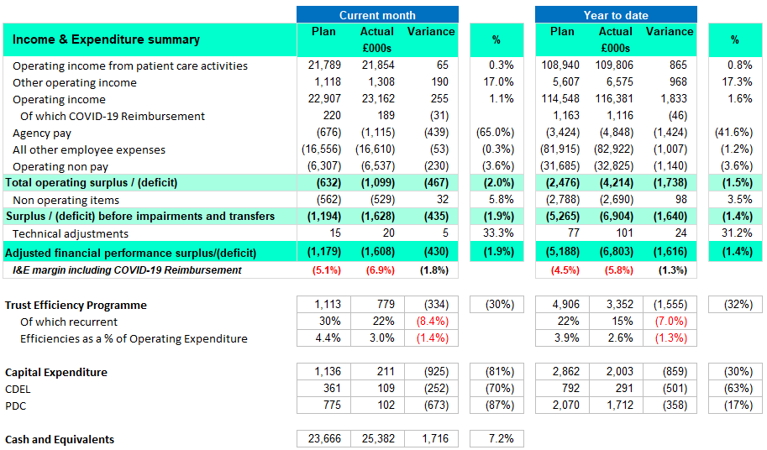
Finance Summary Position – T&G ICFT

Slide 8
Finance Summary Position – T&G ICFT
an for H2 which will result in a planned breakeven position for the financial year 2021/22
Trust Financial Summary – Month 5
At month 5, the Trust reported a deficit of £1.608m against a planned deficit of £1.179m which is an adverse variance of £430k
YTD the Trust is reporting an overspend against plan of £1.616m
The main driving factors behind the overspend position are unachieved TEP and continued pressures within Urgent and Emergency care and delayed discharges.
Efficiency target:
The Trust has set an efficiency target for 2022/23 of £13.628m. In month 5, the Trust delivered efficiencies equating to £779k against a plan of c.£1.113k which is an underachievement of c.£334k. YTD the Trust has delivered c£3.352m – an underachievement of c.£1.555k versus plan.
The Trust continues to review and challenge its efficiency programme and new ideas to close the gap are being worked through with a view to deploying additional efficiency schemes in future months.

