Slide 1




Tameside and Glossop Strategic Commission
Finance Update Report
Financial Year 2022/23
Month 3 – May 2022
Kathy Roe
Sam Simpson

Slide 2
Financial Year 2022-23
Period 3 Finance Report
 | Executive Summary | 3
 | Integrated Commissioning Fund Budgets | 4 - 5
 | Integrated Commissioning Fund Commentary | 6 - 7
 | ICFT Position | 8 - 9
This report covers the Tameside and Glossop Strategic Commission (Tameside & Glossop Clinical Commissioning Group (CCG), Tameside Metropolitan Borough Council (TMBC)) and Tameside & Glossop Integrated Care Foundation Trust (ICFT). It does not capture any Local Authority spend from Derbyshire County Council or High Peak Borough Council for the residents of Glossop.
Forecasts reflect a full 12 months for TMBC, but only 3 months for the CCG for the period 1 April to 30 June 2022. It does not incorporate financial plans for Integrated Care Board which commenced on 1 July 2022.

Slide 3
Finance Update Report – Executive Summary
.
Message from the Directors of Finance
This is the final integrated finance report in it’s current form as the Tameside & Glossop CCG formally closed down on 30th June 2022, with responsibilities transferring to either Greater Manchester ICB or Derby & Derbyshire ICB. From a healthcare commissioning perspective this report looks at 3 months of expenditure based on 25% of locality level ICB plans (as submitted in April 2022). The Month 3 position is an underspend of £1,375k due to allocations not being profiled in line with projected spend. An allocation adjustment is included in the position, bringing the CCG overall variance to nil.
As highlighted in the month 2 report, the Council is facing significant and growing inflationary pressures across a number of areas, combined with demand pressures in Adults and Children’s services, resulting in a significant forecast overspend by 31 March 2023 of (£12,850k). The position has deteriorated since period 2 due to growing pressures in Adults social care, additional pressures on SEN Home to School Transport and an increase in forecast cost pressures and savings shortfalls in Place.
Ongoing demand and cost pressures on Council budgets will have implications for the 2023/24 budget and work is in progress to identify mitigations for 2022/23, whilst planning for 2023/24. The current forecast still assumes a Local Government pay award within the budgeted 2%, which if significantly greater than this will place further pressures on the budget. The forecast position is mitigated slightly by the release of contingency relating to transitional social care costs and additional investment income resulting from interest rate rises.
CCG M3 Financial Position
£1,375k
CCG underspend will be carried forward into Q2-Q4 ICB budgets. Driven by fact Q1 allocations are not profiled in line with projected spend. An allocation adjustment is included in the position, bringing the CCG overall variance to nil.
Council Financial Position
(£12,850k)
The forecast overspend on Council budgets has deteriorated further since month 2 due to growing demand, additional cost pressures and shortfalls in savings delivery.
ICFT Position
(TBC)
ICFT content not yet received – to be updated.

Slide 4
Finance Update Report – Executive Summary

Slide 5
Finance Update Report – Executive Summary

Slide 6
Integrated Commissioning Fund – Q1 CCG Budgets
Tameside & Glossop CCG formally closed down on 30th June 2022, with responsibilities transferring to either Greater Manchester ICB or Derby & Derbyshire ICB. From a healthcare commissioning perspective this report looks at 3 months of expenditure in Q1 only. Plans are based on 25% of locality level ICB plans (as submitted in April), with no profiling for winter or other seasonal effects, which is driving an underspend position for Q1, which will be carried forwards into ICB budgets in Q2 – Q4.
Based upon a national ACRA calculation which estimates that 11.6% of T&G spend relates to Glossop, the CCG has received £13,201k for Glossop in Q1. This allocation is based upon 21/22 spend and does not include any additional funding for growth or inflation. Based on an agreement in principle with Derby & Derbyshire it proposed that IATs for 22/23 should be transacted to adjust the Glossop allocation to reflect a true and fair split of the resources required and being consumed. Subsequent Glossop transition review meetings would then be held throughout 22/23 to ensure material changes were not being experienced in either system. This is still to be formally agreed with Derby & Derbyshire. Budget analysis of the YTD position for Q1 split by Tameside and Glossop is shown below:
Acute: Over performance on NHS providers relates to an accrual for the 0.7% additional inflation that was agreed in June 2022 (£449k, which the ICB will receive an allocation for in Q2). This is offset by underspend in the Independent Sector where activity is lower that the Elective Recovery Fund aspiration. NCA is overspent due to mandated LVA contracts with English NHS Trusts which were planned for at ICB level.
Mental Health: Glossop budgets do not include inflation or growth which is creating an overspend. The overspend in Tameside is based on GM level investment plans – other localities underspending to give overall balance at GM level, while ensuring MHIS compliance. This is partially offset by under spends in Individualised Commissioning.
Continuing Care: Budgets based on 25% of annual plan, so include funding for winter. The CCG would be broadly on track but for lack of winter profiling in allocation. Glossop has a number of patients on high cost care packages.
Primary Care: Winter profiling on prescribing is driving underspend, which is offset in Glossop as growth was not factored into the allocation.
Savings & Efficiency: The overall annual savings target is £7,977k. To date £1,441k of QIPP has been achieved from Cross year benefits (£1,171k), Budget Management (£220k) and Prescribing rebates (£50k)
Allocations: The final quarter 1 position is an underspend of £1,375k. This will be the value of the final CCG closedown allocation adjustment which will be carried forward into Q2 – Q4.
 | YTD Budget |  | YTD Variance |  |  | Tameside & Glossop Total
 | Tameside | Glossop | Tameside | Glossop |  | YTD Budget | YTD Variance
ACUTE | 53,387 | 5,827 | -19 | -77 |  | 59,214 | -97
MENTAL HEALTH | 10,900 | 1,520 | -217 | -54 |  | 12,420 | -272
COMMUNITY HEALTH SERVICES | 8,432 | 738 | 47 | 19 |  | 9,170 | 66
CONTINUING CARE | 3,546 | 580 | 488 | -116 |  | 4,126 | 372
PRIMARY CARE | 20,190 | 2,871 | 485 | -288 |  | 23,061 | 197
OTHER | 4,343 | 1,523 | 186 | 701 |  | 5,866 | 887
CORPORATE | 1,062 | 143 | 78 | 143 |  | 1,206 | 222
Grand Total | 101,860 | 13,201 | 1,047 | 328 |  | 115,061 | 1,375

Slide 7
Integrated Commissioning Fund – Council Budgets
As highlighted in the month 2 report, the Council is facing significant and growing inflationary pressures across a number of areas, combined with demand pressures in Adults and Children’s services, resulting in a substantial forecast overspend by 31 March 2023 of (£12,850k). Further detail on key variances and progress with savings delivery is set out in Appendix 2 with key variances including:
Adults £2,716k : The forecast includes £1,712k of costs relating to transitional placements from Children’s Services during 2022/23, which is based on current data and assumes a reduction in costs relating to eligibility rates and client contributions. Pressures of £1,550k have also materialised due to COVID grant related funding not being available as expected at budget setting, which is partly mitigated by £734k of contributions from reserves. Pressures of £933k have also materialised in Residential and Nursing Care due to an increase in the number of placements above that assumed at budget setting. transitional placements (young adults), shortfall in COVID related grant income, increase in volume of residential & nursing placements. The pressures are partially mitigated by the reserve drawdown relating to COVID grant income, vacant posts across the service and an increase in Continuing Health Care funding to contribute to placement costs.
Children’s Social Care £2,405k : External Placements is forecast to overspend by a total of (£2.494m). The overspend is predominately due to the number of external residential placements for children under 18 (£1.981m). Additionally there is an overspend of (£0.559m) in relation to the number of young adults that remain in placements paid for by Children’s Social Care due to the lack of appropriate accommodation for them to move onto. Work is continuing in this area with the Transformation Team to address sufficiency of appropriate accommodation and it is expected this will reduce costs in this area. Interagency adoption fees is forecast to underspend by £46K due to the number of children placed with adopters from the Regional Adoption Agency. The budget for external residential placements was reduced by £2.919m as part of the council savings for 2022/23. The approved savings was based on a reduction in the number of cared for children in external residential placements and a reduction in costs by stepping children from residential homes to agency foster care placements. The saving is currently not on target to be met.
Education £1,729k – The budget for SEN Transport is expected to overspend due to the continued rise in the numbers of pupils eligible for transport, along with an increase in price inflation contributing to this pressure. A further review of the costs has seen the pressure increase from Period 2 as demand on the service has further increased. Routes are due to be updated from September and estimates for anticipated growth and inflation included.
Place £7,903k : There are a range of pressures across the Directorate which include: (£1,358k) additional costs for street lighting electricity and (£849k) additional costs for gas and electricity in buildings, based on approximately 100% increase in prices; (£371k) inflationary pressures on facilities management costs; (£400k) reduced income from estates services; (£229k) forecast reduction in income from planning and building control; (£490k) income shortfalls in Engineers; (£907k) shortfall in car parking income; and pressures totalling £2,705k due to the non-delivery of savings.

Slide 8
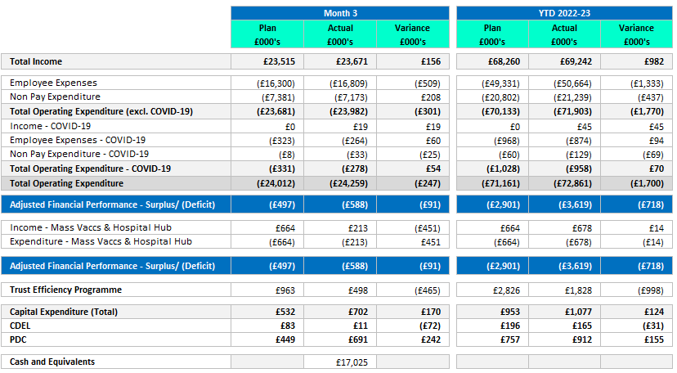
Finance Summary Position – T&G ICFT

Slide 9
Finance Summary Position – T&G ICFT
an for H2 which will result in a planned breakeven position for the financial year 2021/22
Trust Financial Summary – Month 3
The Trust had original submitted a planned deficit of c.£15.567m but has recently resubmitted with a planned deficit of c.£12.311m following receipt of additional revenue support funding.
In month 3 the Trust reported an in month variance against plan of c.£91k adverse and a YTD position of c.£718k adverse. This is largely driven by following key factors:
Premium agency spend within ED and Urgent Care
Additional costs due to delay transfer of care for inpatients to social care
Unachieved Trust Efficiency Programme which is compounded by two points above
The in month actual position is a reported deficit of c.£0.588m. This represents an favourable movement of c.£1.1m compared to the previous month, predominantly due to the YTD additional revenue funding included at Month 3 to support inflation which is reflected in the improvement of the overall Trust plan. Total COVID expenditure incurred in month equated to c.£278k against planned spend of c.£331k which is slightly below plan. Total YTD spend for COVID is c£958k against a plan of c.£1.028k which represents an underspend of £70k.
Activity and Performance:
Activity plans set for the Trust for 2022/23 are in line with nationally prescribed activity targets. Assuming activity plans are met, this will enable the Trust to access Elective Recovery Funding (ERF), although payment is dependant upon achievement of activity targets on a Greater Manchester System-wide footprint.
Despite the continued operational challenges that the Trust is experiencing in terms of high levels of A&E attendances, bed availability and high levels of patients who no longer meet the criteria to reside, the Trust is performing well against its Elective, Day case and outpatient attendance targets, but is reporting below the threshold of 104% overall.
Efficiency target:
The Trust has set an efficiency target for 2022/23 of £13.628m. In month 3, the Trust delivered efficiencies equating to £651k against a plan of c.£963k which is an underachievement of c.£280k. YTD the trust has delivered c£1.981m – an underachievement of c.£749k versus plan.
The Trust continues to review and challenge its efficiency programme and new ideas to close the gap are being worked through with a view to deploying additional efficiency schemes in future months.

