Slide 1
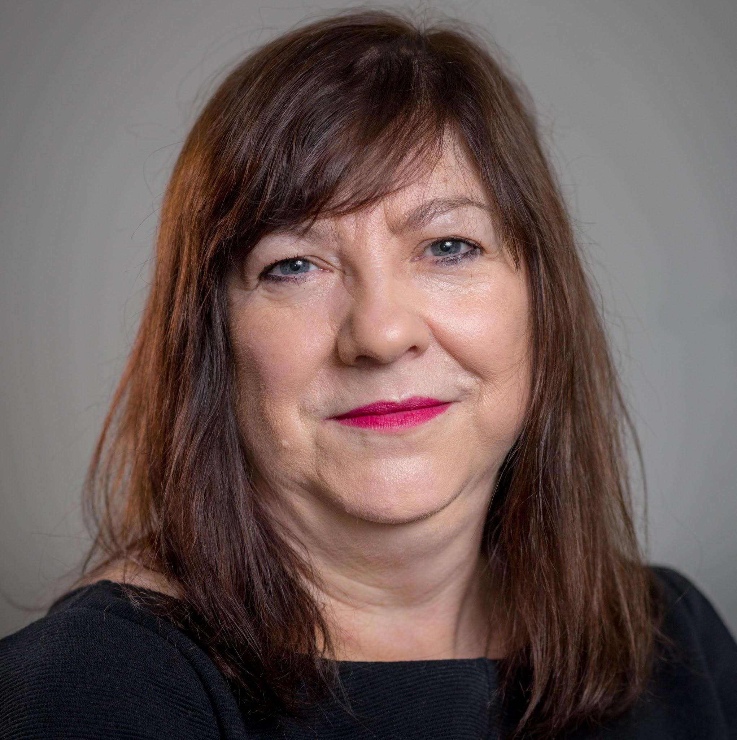
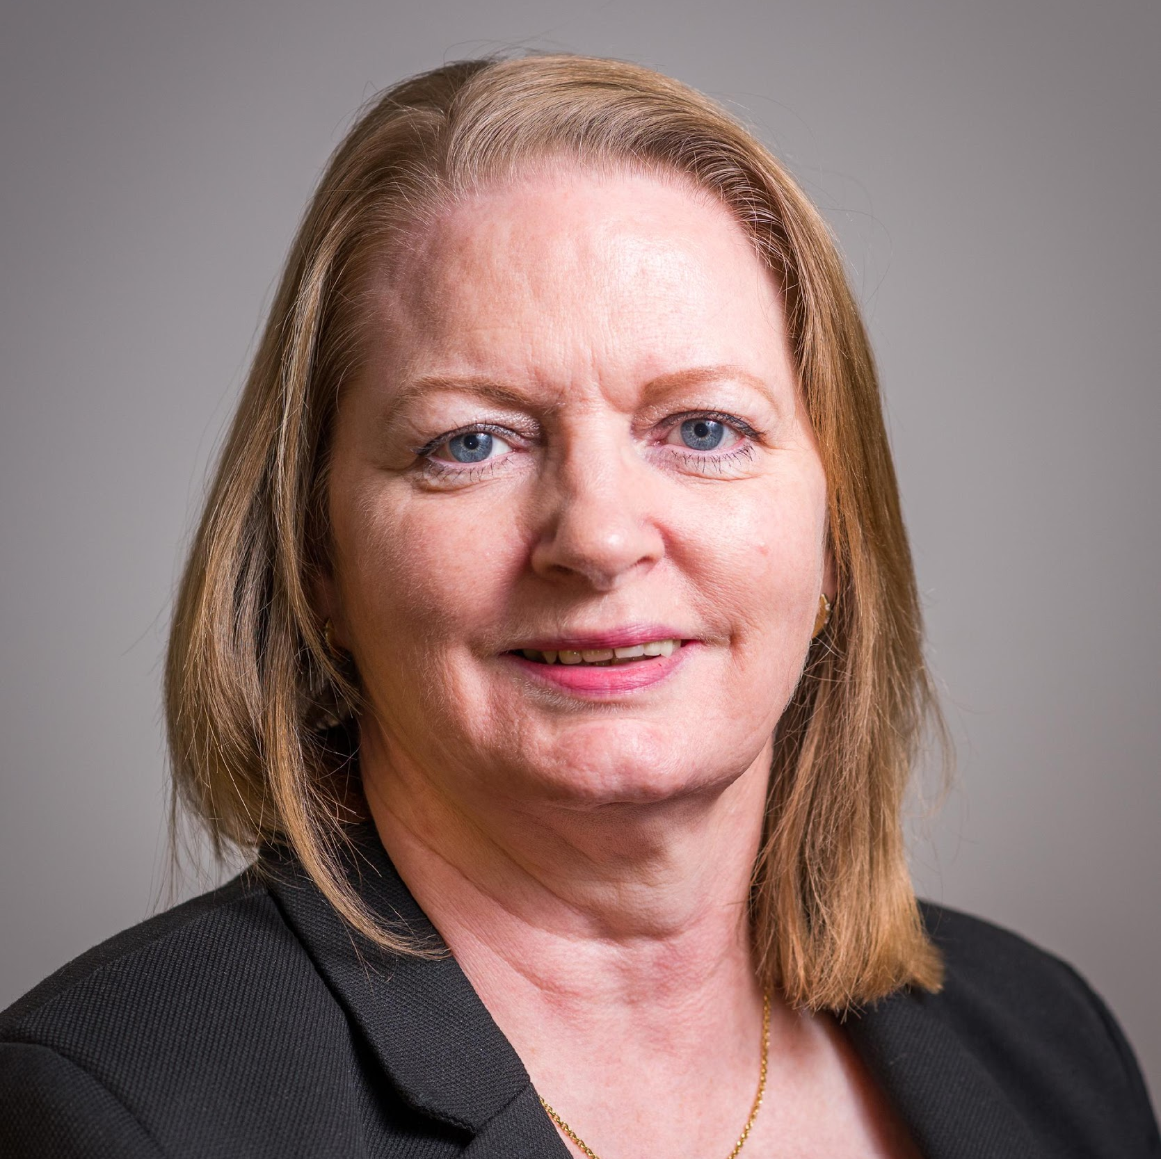
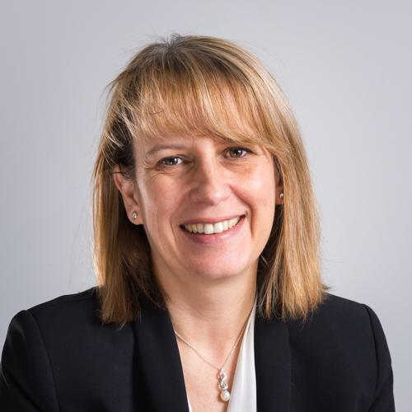
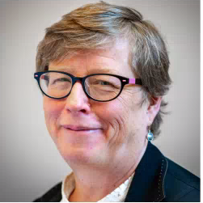
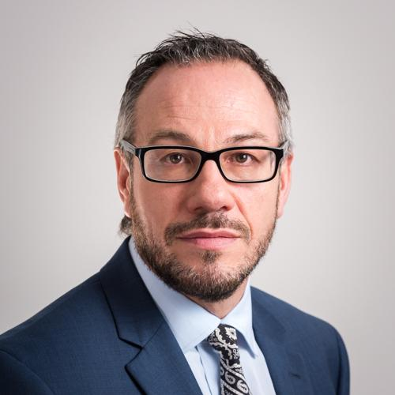
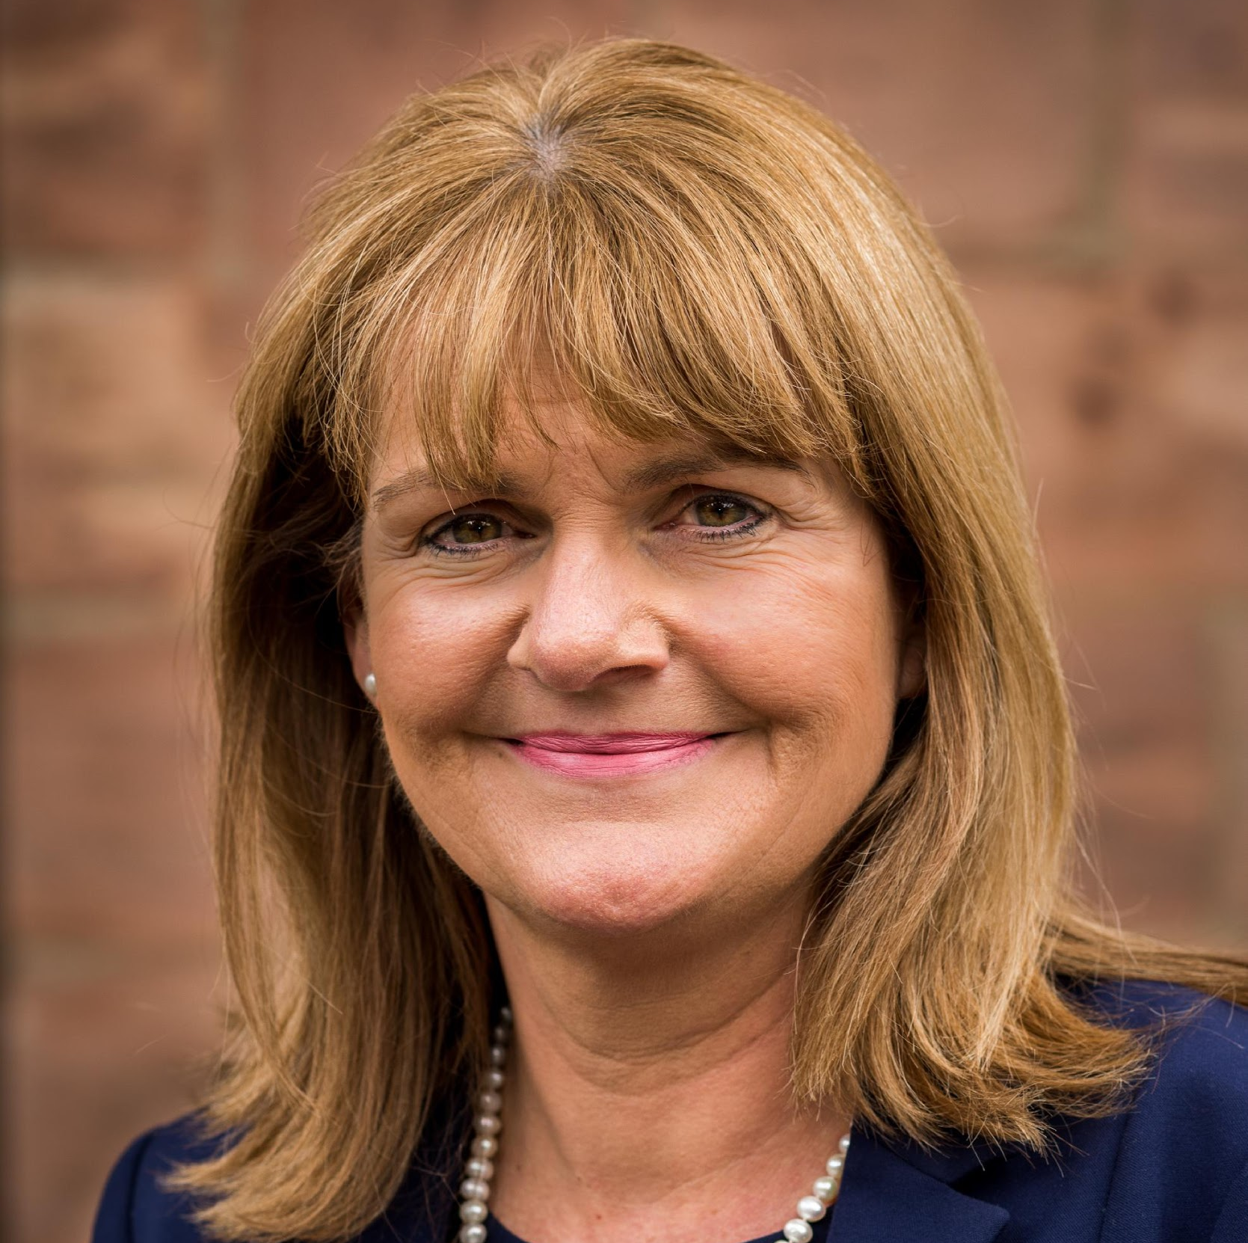
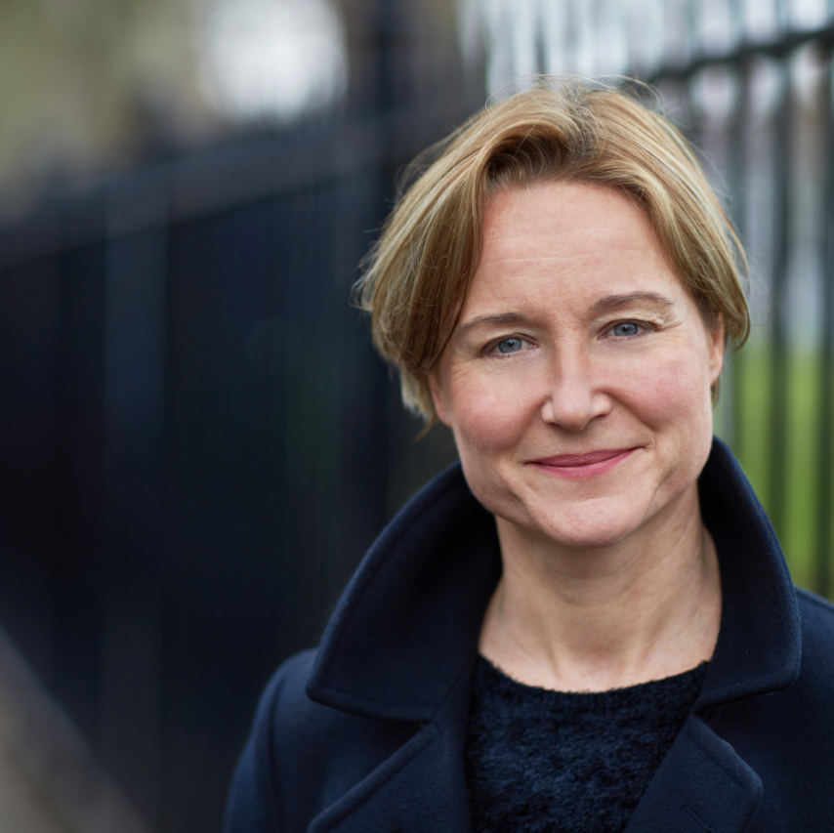
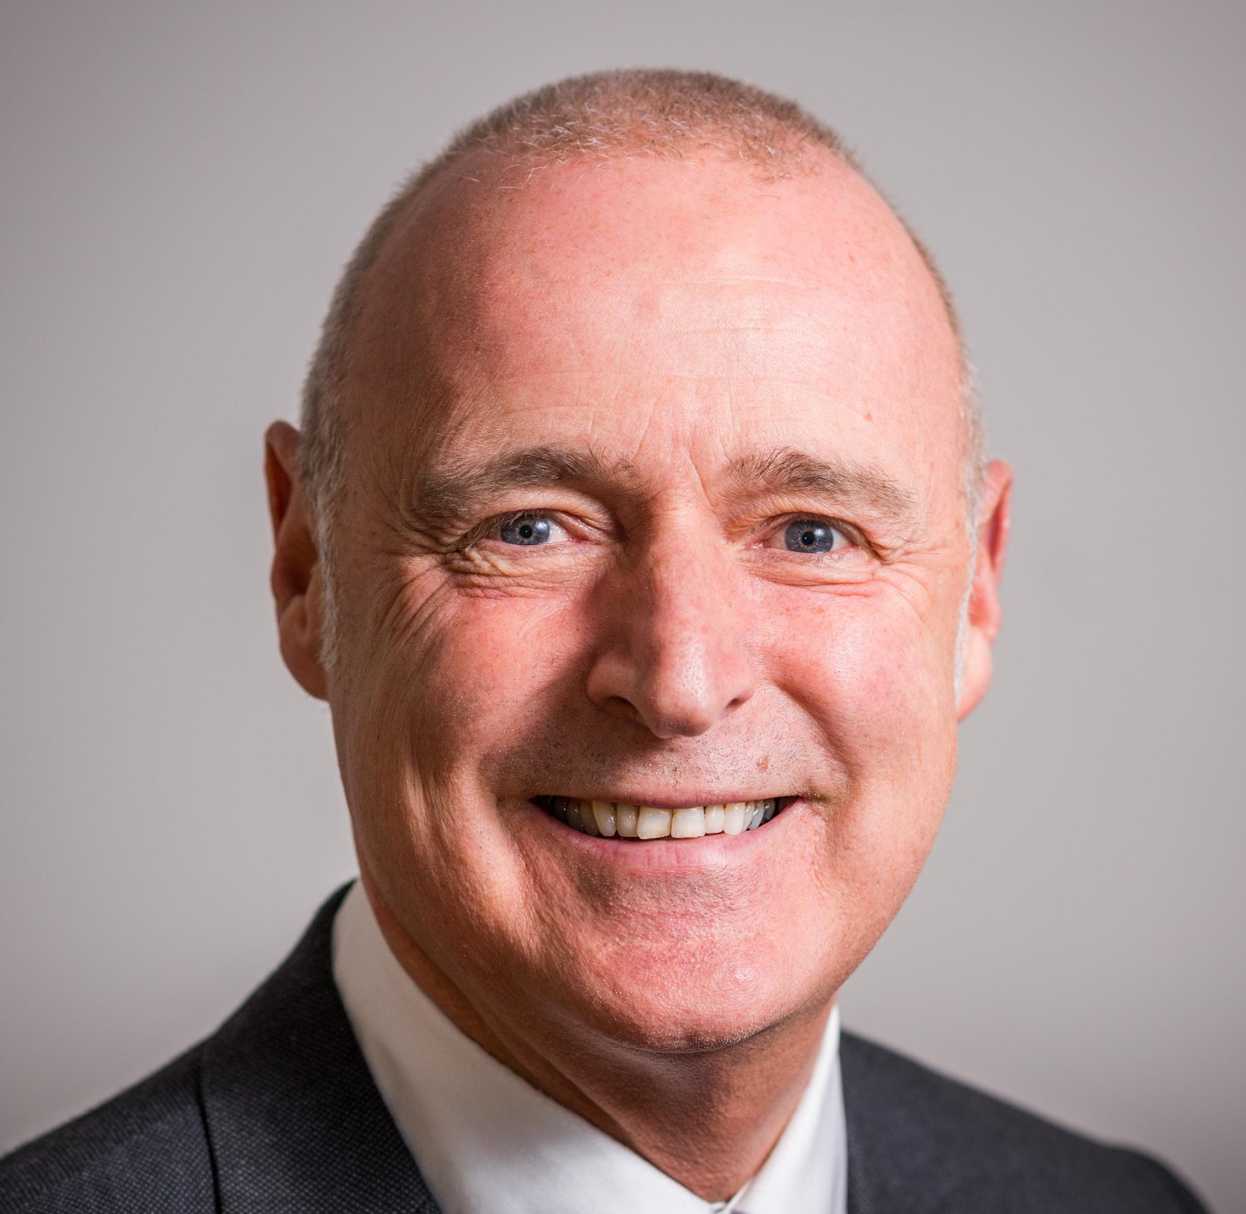
Joanne Roney
Chief Executive
Grade CEX
Fiona Worrall
Strategic Director (Neighbourhoods)
Grade SS5
Carol Culley
Deputy Chief Executive & City Treasurer
Grade DCX
Fiona Ledden
City Solicitor
Grade SS5
Paul Marshall
Strategic Director (Children’s & Education Services)
Grade SS5
Bernie Enright
Executive Director of Commissioning & DASS
Grade SS5
Louise Wyman
Strategic Director
(Strategic Development)
Grade SS5
David Regan
Director of Population Health & Wellbeing
Grade SS4
Senior Management Team

